Slide 1
5S & Visual Management Playbook TEC-406-160018
August 2020
Global Operations

Slide 2




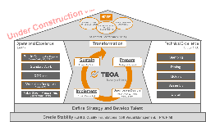
Using this Playbook – What do the Icons Mean?
Where this Icon is visible refers to a Tip / help
Where this Icon is visible refers to a point of information on the subject, linking to additional Playbooks or Training materials for example
Where this Icon is visible refers to a special Note on the subject
Click on the agenda icon to return to the agenda for the current phase
Click on the House Icon to return to the TEOA House page
Return to Agenda

Slide 3
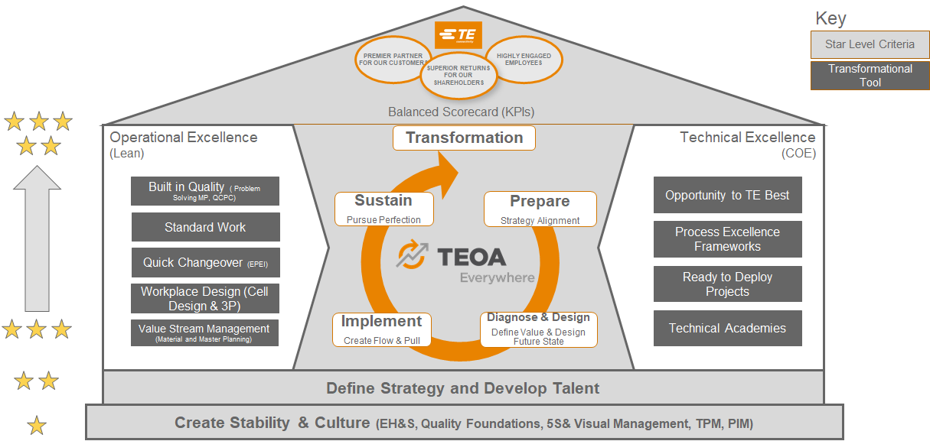
TEOA – Operations Management System

Slide 4
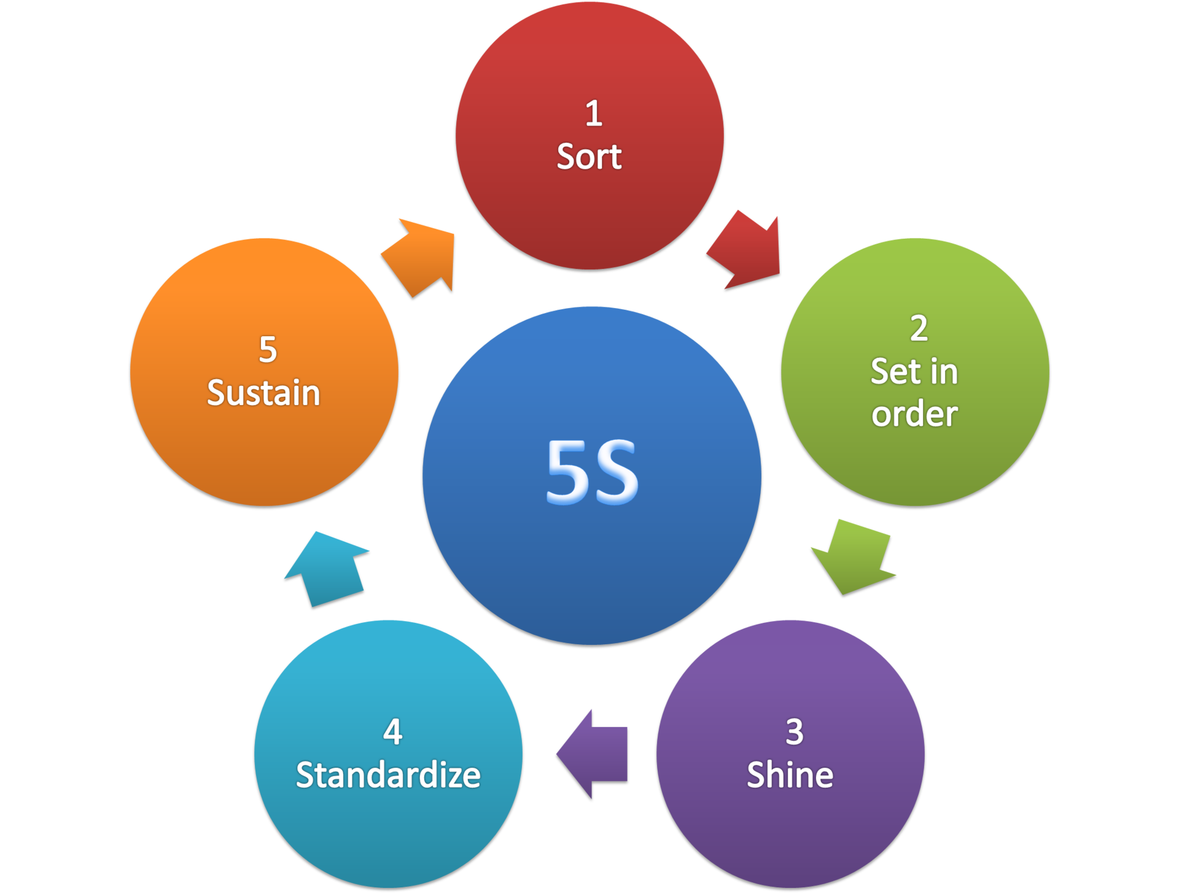
5S
A structured approach consisting of 5 steps designed to create workplace organization and process optimization by developing a culture of discipline and order.

Slide 5
5S Overview
Definition
What is the Purpose
Why Use it
How to Implement 5S
Examples of 5S
BDP repository on 5S
Diagnostic Questions
In this Playbook:
A definition of what is 5S
What is the Purpose of 5S
Why use 5S
How to implement 5S with training materials & best practices
Note: Click on the links above to quickly access the topic

Slide 6
1. 5S Definition
A structured approach consisting of 5 steps designed to cause workplace organization and process optimization by developing a culture of discipline and order.
“A place for everything and everything in its place”.
It applies to all areas and requires everyone´s continuous involvement.
Its purpose is on usefulness and not just on the esthetics.
“Don´t let the perfect be the enemy of the good”
Make 5S a “daily activity”, instead of a “once in a time cleaning task” for external audits, visits, etc.”
Return to Agenda

Slide 7
2. What is the purpose
Reduce the risk of accidents and making mistakes.
Perform the work faster without wasting time and effort.
“Management by exception”
Create a sense of pride and ownership.
Engage everyone in continuous improvement.
Return to Agenda

Slide 8
3. Why Use 5S
Benefits:
PEOPLE
QUALITY
PERFORMANCE
Increased safety.
Cleaner work environment.
Increased ownership and sense of pride.
Easier maintenance
Greater visibility of mistakes
Easier standardization of work
Increased productivity
Reduced setup time
Fewer breakdowns
Less wasted time
Sets the foundation for discipline to follow standardized work
Return to Agenda

Slide 9

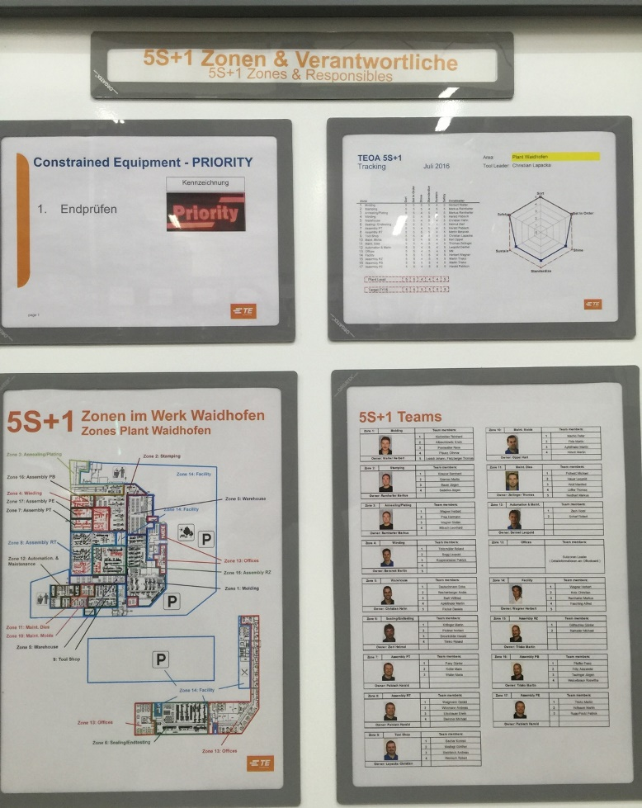
4. How to implement 5S
Prepare:
Site Leadership Teams have completed 5S training per TEOA 107 5S.​
Divide the work areas into manageable “Zones” and/or “Subzones” where there are sufficient people to take action to improve. Usually less than 10 (Sub)Zones per facility including all office, production, storage and outside areas.
Assign a (Sub)Zone Leader who will be responsible for leading the necessary activities to increase the 5S zone score as documented on Form 5102.
Form a core implementation team to lead the planning process and manage the implementation. This team is usually comprised by the TEOA Site leader and a 5S coordinator/champion.
Introduce the concept of 5S to all the (Sub)Zone Leaders and shop floor workers. It can either be used the Training Material TEOA 107 or the Introduction 5S training video from the GEMBA Academy to the team.
Create and install a display/communication board for each (sub)zone where the weekly audit results can be displayed.
Refer to TEOA 107 5S for Training Materials and Supporting templates
Example of Display/Communications board from IND Waidhofen Site
Return to Agenda

Slide 10
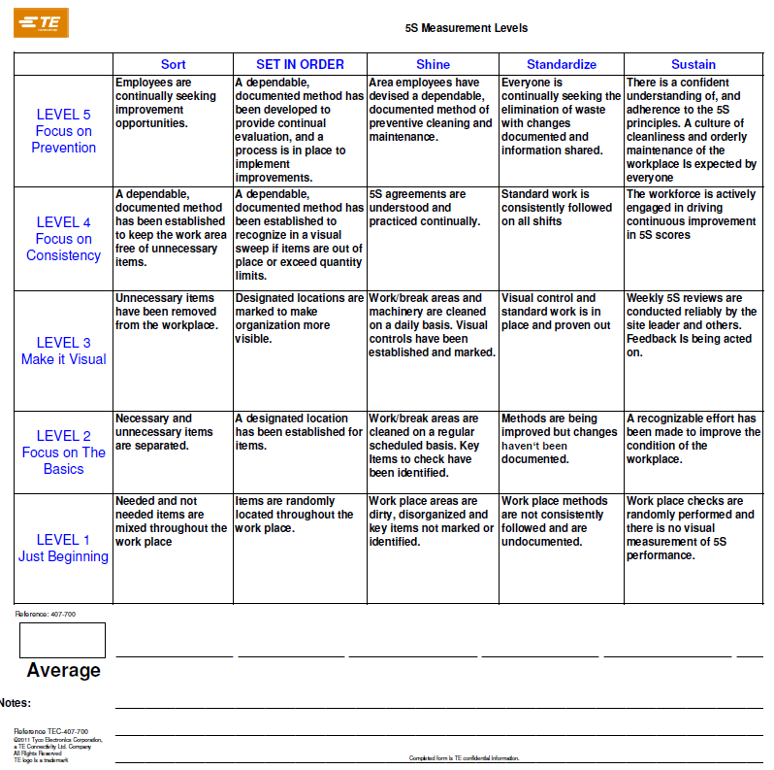
4. How to implement 5S
Diagnose and Design:
Use TE Form 5102 or Form 5090 to complete a current state 5S assessment to create a baseline for improvement.
Note: TE form 5102 is also available on DM TEC
In conjunction with local management, establish the next target for 5S score.
Communicate the initial 5S assessment score to all stakeholders, as well as the resulting plans to move forward.
5102
5090
Return to Agenda

Slide 11
4. How to implement 5S
Implement:
Sustain:
1 – SORT | Identifying and keeping only the materials, tools and equipment necessary to successfully complete the work.
2- SET IN ORDER | Organizing the workplace so that the tools and materials that are necessary to complete the job are readily available and integrated into the flow of the work. There is a place designated for each item and each item is in each place.
3-SHINE | Cleaning and inspecting the work area and equipment on a daily basis to ensure that everything is in the proper location and functioning properly.
4 – STANDARDIZE / VISUAL MANAGEMENT | Standardizing on the best practices and methods. Making the standards visual and obvious. This becomes the baseline for continuous improvement.
5 – SUSTAIN | Perform regular 5S audits to ensure compliance to standards and continuous improvement of them.
Return to Agenda

Slide 12
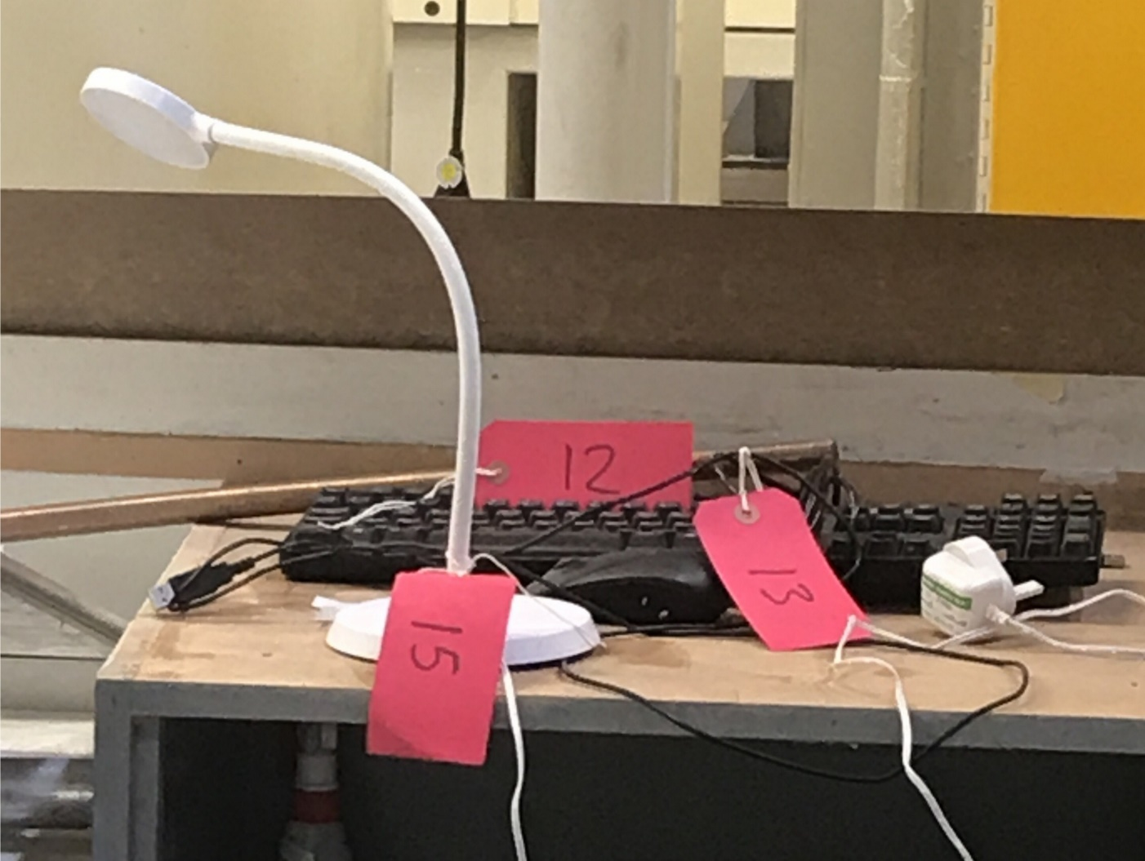
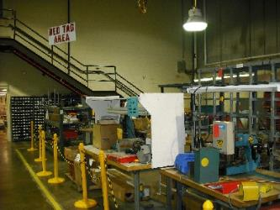
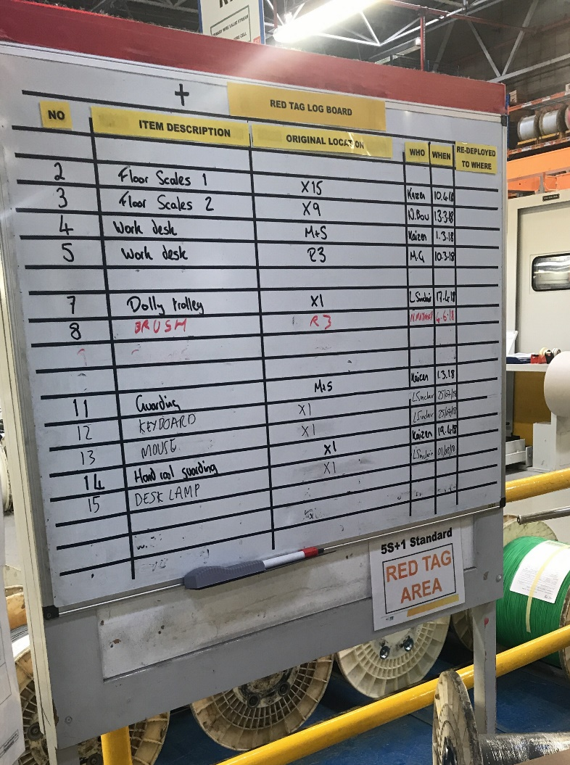
5S Best Practice Examples
1- SORT
“Red tag area”: everything that is not necessary for the area of study, duplicated or/and in excess
Example of RED Tags on items that were not required and have been moved to a RED TAG Area
Example of RED Tag Area with sign identifying the area plus barriers to separate it from production
Example of RED Tag Area log. In this case it is a white board to help track what moves in and out of the area
Click here to access a simple printable RED TAG Template
Return to Agenda

Slide 13
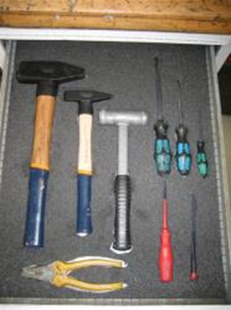
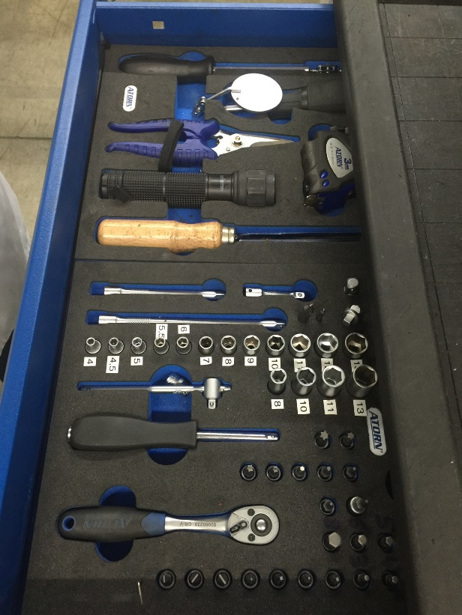
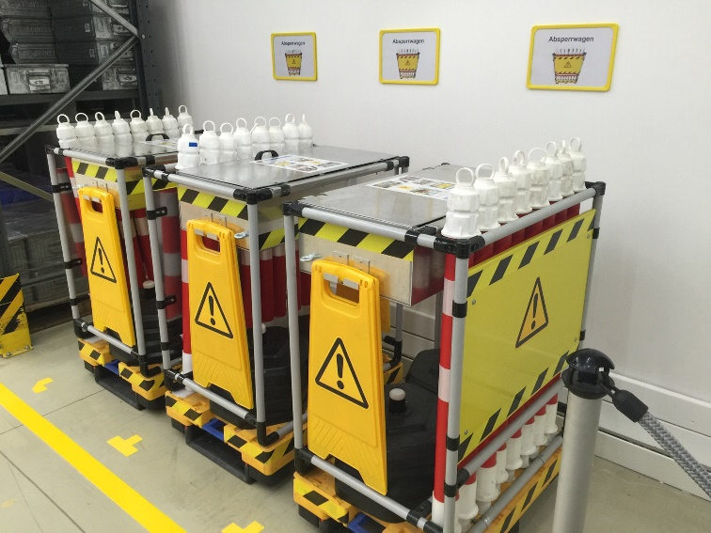
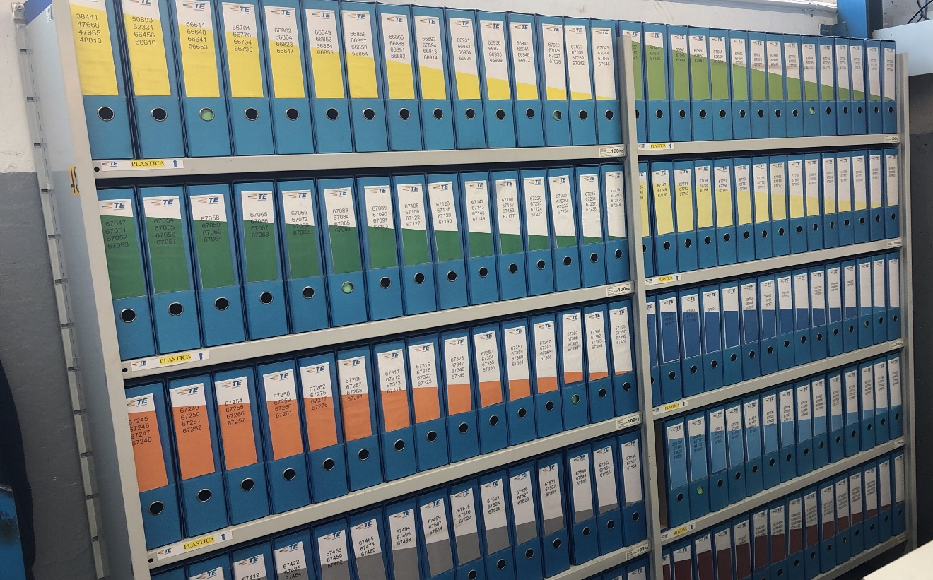
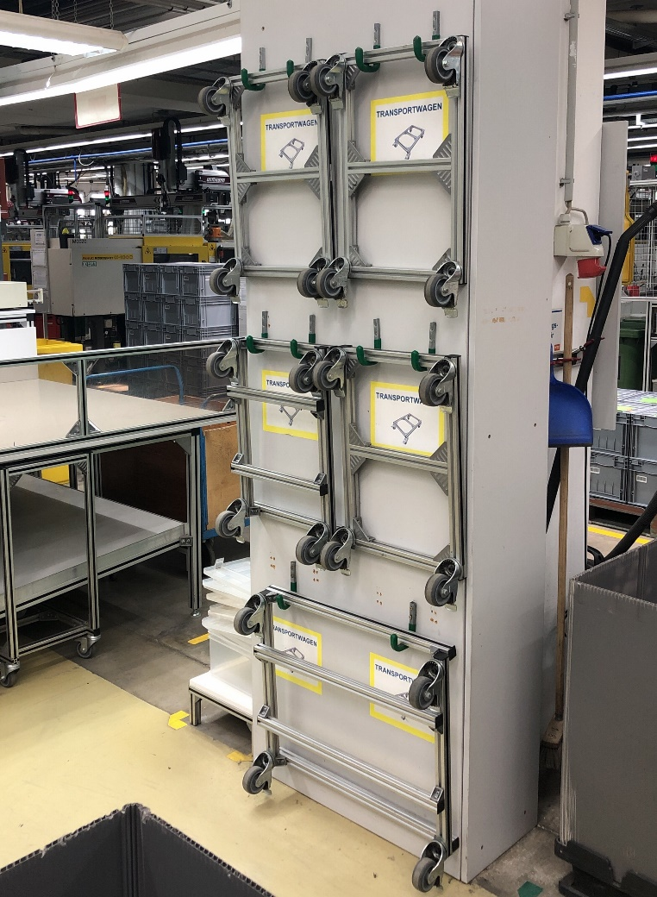
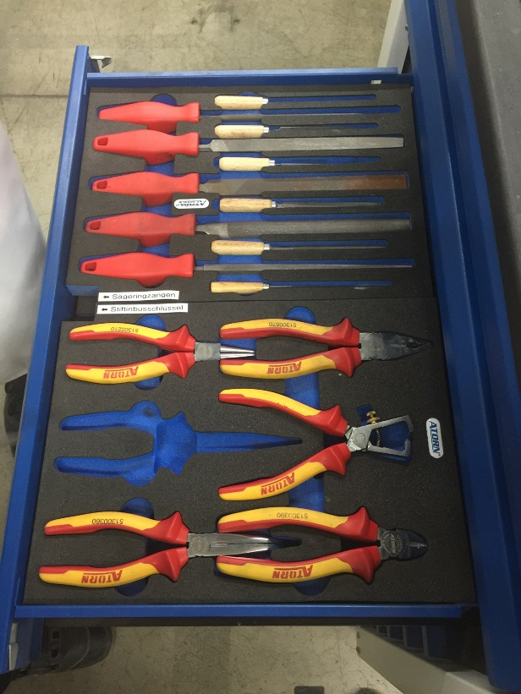
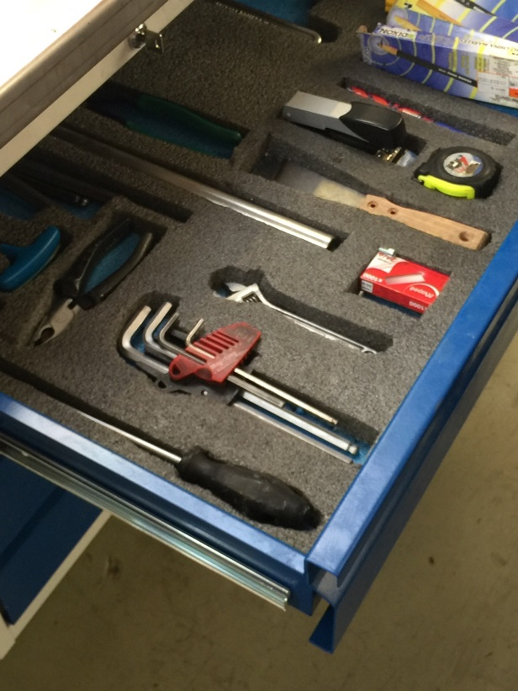
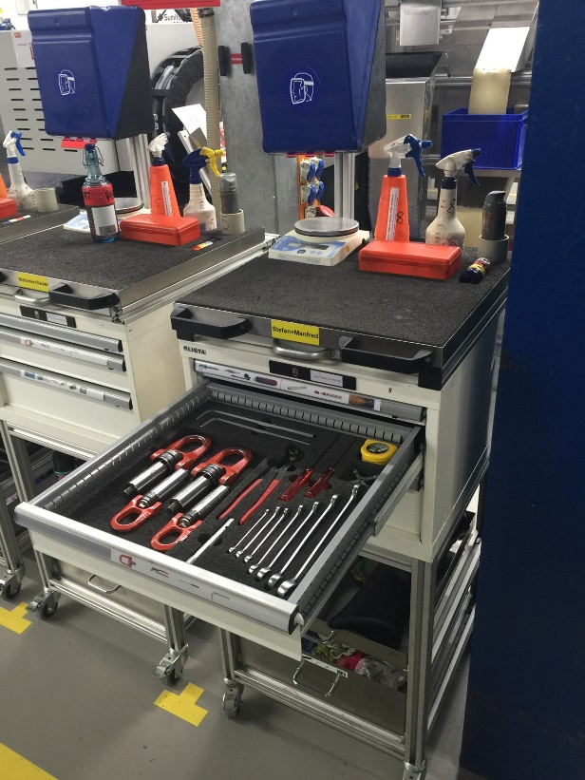
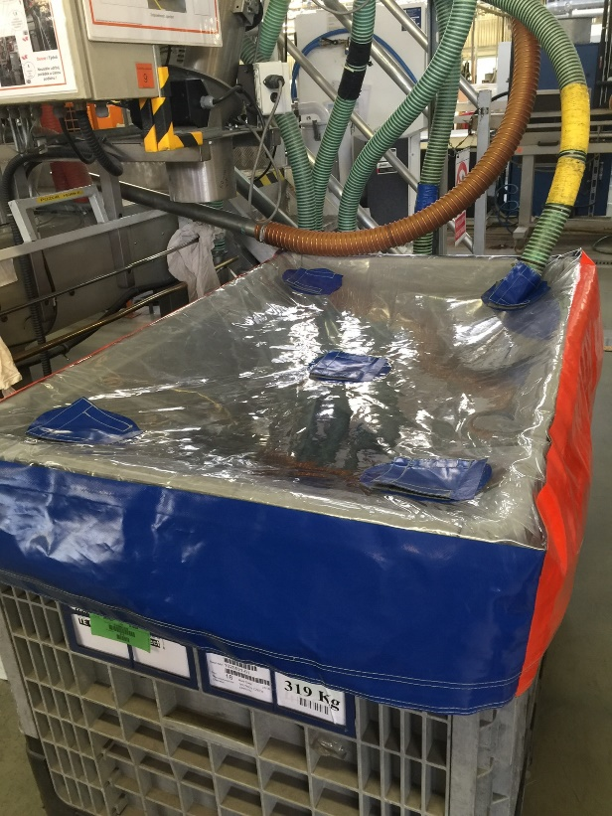
5S Best Practice Examples
2- SET IN ORDER
“A place for everything and everything in its place”
Designate and mark the locations of tools, materials, etc.
Return to Agenda

Slide 14
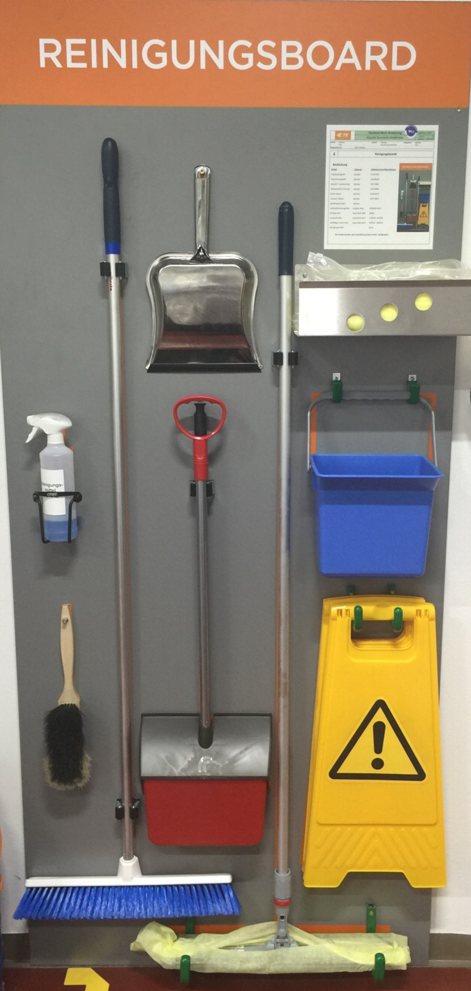
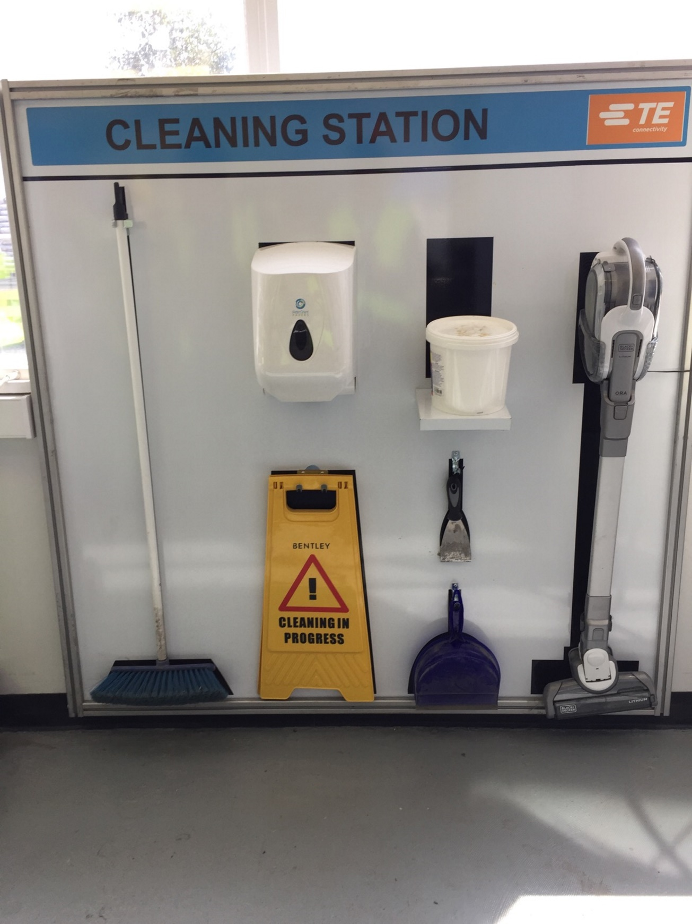
5S Best Practice Examples
Examples of cleaning stations which allow employees easy access to equipment and materials.
3- SHINE
Cleaning Station from Industrial Relay Waidhofen Austria.
Cleaning Station from Energy Witham UK.
Return to Agenda

Slide 15
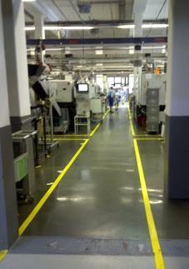
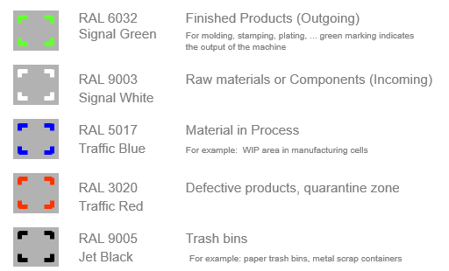
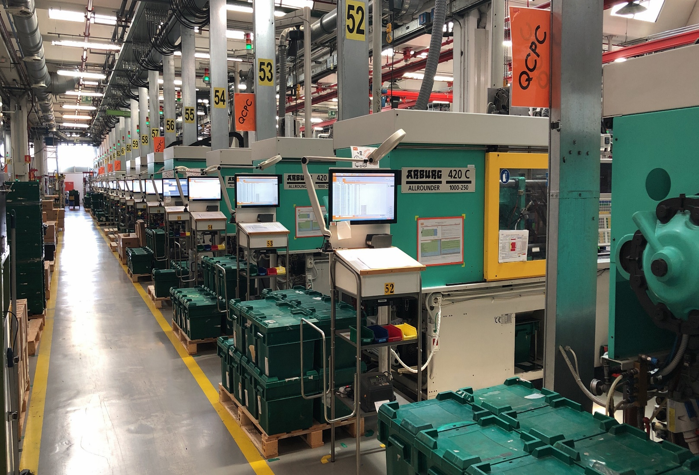
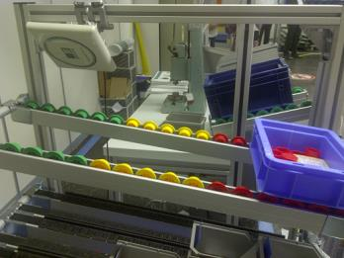
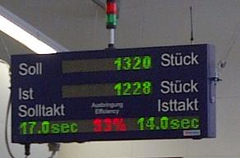
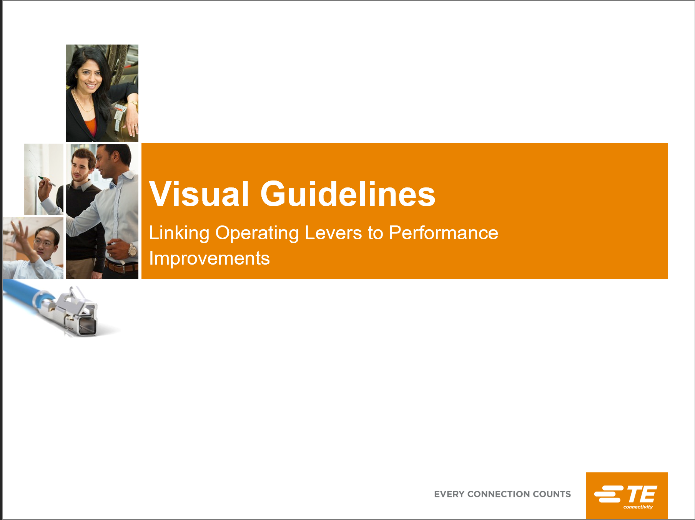
5S Best Practice Examples
4- STANDARDIZE & VISUAL MANAGEMENT
Floor markings
Standard for visual management for Floor Markings
Shop floor Automotive San Salvo Italy
Click here to access a TEOA 124 Visual Guidelines materials
Process and Production Status
Return to Agenda

Slide 16

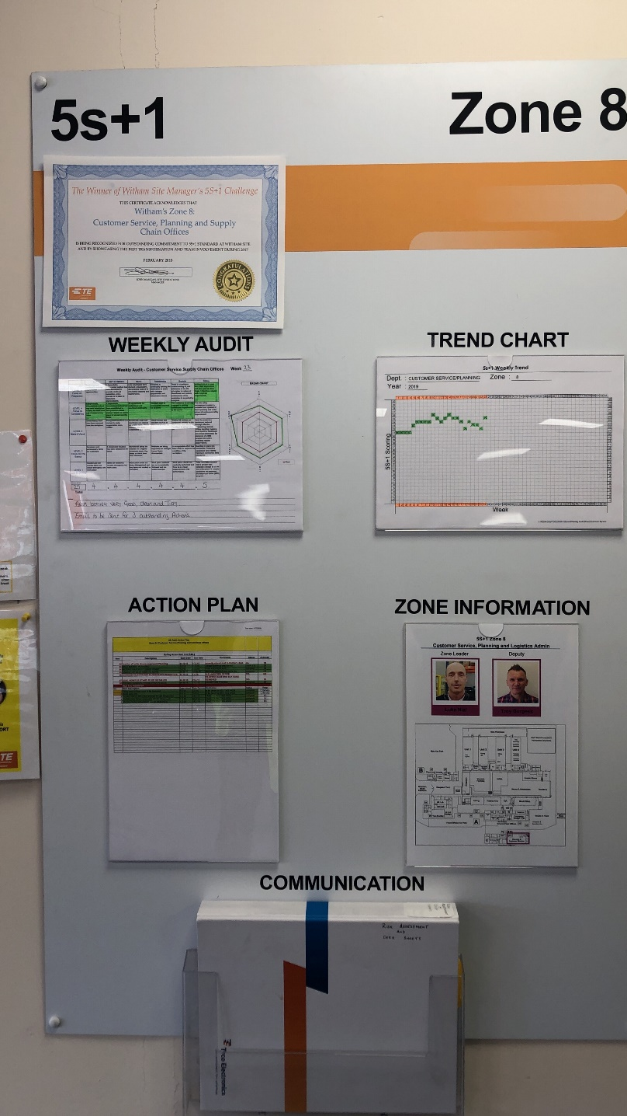
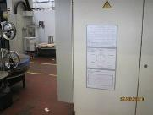
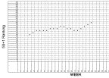
5S Best Practice Examples
5- SUSTAIN
Example of a 5S Zone Board
Example of a 5S Sub- Zone Board
Zone area identified
5102 Form
Award presented to the best zone
Radar Chart
5102 Form used for rating the zones
Tracking of performance
Trend Chart
Zones and leaders information
List of actions identified during 5S Audit
Weekly audit by 5S subzone Leaders
Radar Chart and Trendchart updated (hand-written).
Each Zone has a 5S score-board to display 5S status
Suggestion box for Improvement ideas / concerns etc.
Click here to access a Template for a Radar Chart and Trendchart
Return to Agenda

Slide 17
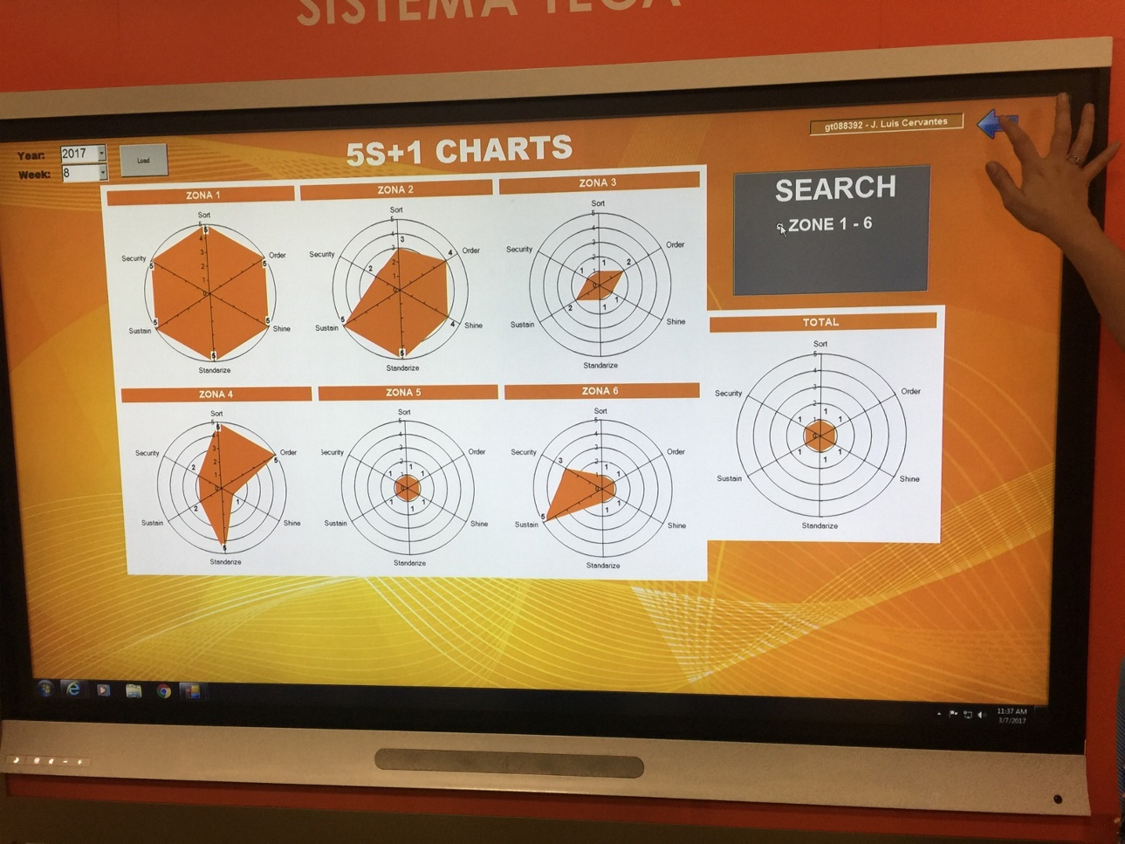
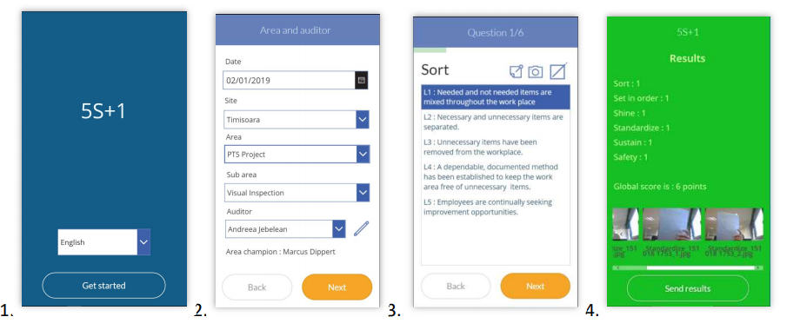
5S Best Practice Digital Examples
Example of a Digital Application for displaying 5S Audit results on an interactive touch screen
Digital Application for conducting 5S Audits
Return to Agenda

Slide 18

5S “The Numbers Game”
For additional learning experience or to help teach the message of 5S the “Numbers Game” then click here
Return to Agenda

Slide 19
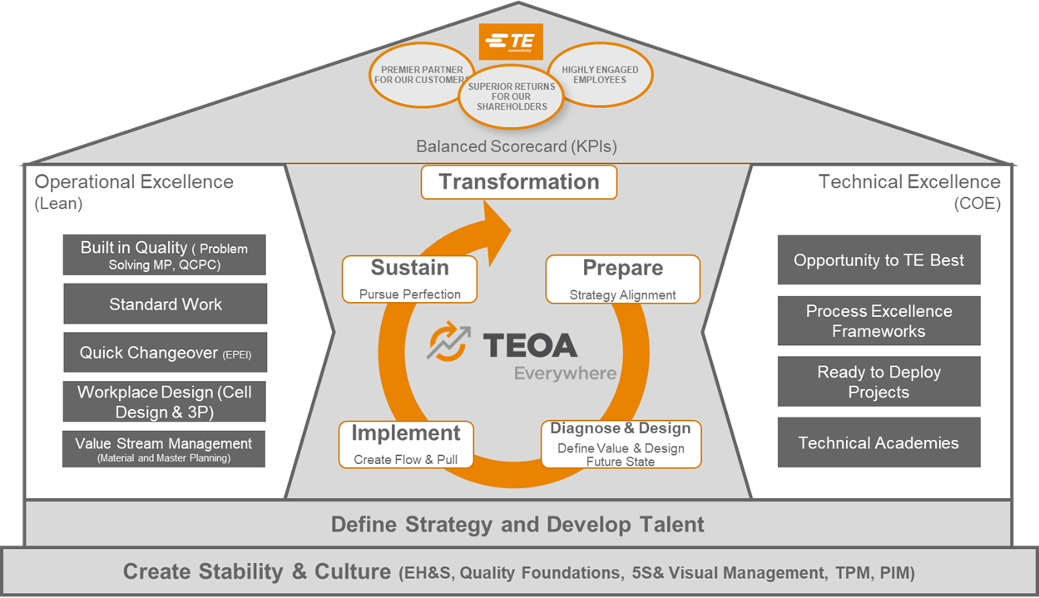
5 Access to Shared Best Practices
Click here to Search 5S SDPs
Return to Agenda

Slide 20

5S - Improvement Over time
Prepare
Diagnose & Design
Implement
Sustain
The cycles surrounding 5S continue to mature as the site evolves over time.
See Diagnostic Questions on next page to help understand the sites level
Prepare
Diagnose & Design
Implement
Sustain
Cycles of Improvement
Prepare
Diagnose & Design
Implement
Sustain
Site 5S Path
Note
There that is no formal Assessment for this tool at Star level 3,4 or 5, however the expectation is for the cycles of Improvement to continue as the site matures.
Prepare
Diagnose & Design
Implement
Sustain
Stabilised
Prepare
Diagnose & Design
Implement
Sustain
Beginning
Time

Slide 21
Questions to Consider around 5S Deployment
Beginning
Has an initial self assessment has been completed regarding 5S on Site?
Have the site leadership teams have completed 5S training and do they understand the methodology?
Have all employees completed SF 101 & 102 training (Shop floor) Has this has also been incorporated into new employee orientation process.
Have site wide zones been established?
Are weekly audits conducted by the site manager or designee? Are the results documented? Are they posted in the zone, physically or digitally.
Has a RED Tag Area been established?
Stabilised
Has 5S been deployed in all departments throughout the entire site including production, warehousing, office areas and external
Is the Site manager and key leaders conducting routine 5S walks which are included in their leader standard work?
Has a minimum score of 2.0 on the assessment, utilizing the TE Form 5102 for example been achieved?
Are actions from audits being collected? Are they being closed out?
Are "Colours, floor markings, tool outlines, containers identified and marked to make it clear where things belong AND when they need to be replenished?
Is the RED Tag area working as defined?
Cycles of Improvement
The expectation is the cycles of improvements will continue as the site matures.

